Slide 1
Welcome to Middle School!
We’re so glad you’re here!
​

Slide 2


AGENDA
Who’s Who
Dress Code
Demerits/Detentions/IAC
Cell Phones
Social Media/Overpass
TIPS for being a Fundamental Student
Fears of a Middle School Kid
Questions
Activity
​

Slide 3

Who’s Who of
Mad Beach
Principal: Mr. Ateek
Assistant Principals: Mrs. Altenore and Mrs. Crandall
School Counselors: Mrs. Vermillion (last names A-K) and Mr. Rosenberger (last names L-Z)
School Nurse: Nurse Kendra
Office Support: Mrs. Ivy, Mrs. Bandoni, Ms. Frey

Slide 4
Dress
Code
Students in the fundamental schools are expected to exercise good judgment and dress in a responsible manner
Students violating the dress code will be sent to the office to call their parents and request a change of clothing.
The student may be issued a warning or a detention for violation of the dress code policy. Repeated violations may result in a referral to the school’s Intervention and Appeal Committee.

Slide 5


Acceptable Dress:
Dresses or skirts may be no shorter than 3” above the knee (including when leggings or jeggings are worn underneath). Top of the slit in a skirt may be no more than 3” above the knee.
Shirts, blouses and/or sweaters for both boys and girls – at no time should bare midriff be exposed including sitting, bending, standing or raising your hands over your head. - All shirts, tops, and dresses shall have sleeves and cover the shoulders.
Shoes with some form of heel strap
“

Slide 6

Shorts my only be uniform shorts, of proper length and in the one of the following colors: khaki, navy blue or black
Shirts must have sleeves (no tank tops)
No hats
No flip-flops, Crocs, sandals without straps
No tops with a plunging neckline
No visible body piercing (except ears)
No writing or drawings on the body
No loungewear (such as pajamas or yoga pants), spandex or jeggings
No clothes with holes, tears or are see-through
No unnatural hair color (to include streaks)

Slide 7

PE Class
*You will dress out when you have PE
Dress Code for PE:
A change of clothing
Secured laced shoes
Any color t-shirt
Basketball-type/sport shorts that are no more than 3 inches above the knee
You will be given a gym locker and lock. You might have to share a locker.

Slide 8
- No homework or incomplete homework = 2 demerits
- No parent signature on homework = 1 demerit
Not bringing materials to class = 1 demerit
12 demerits in a grading period = IAC
Demerits
Detentions
Detentions may be given for breaking the School Code of Conduct.
Some common reasons include, but are not limited to: gum, missing parent signatures on progress report, rude behavior towards others
There is a 10 day grace period to help you get acclimated
10 Detentions in a school year = IAC

Slide 9

Intervention & Appeal Committee (IAC)
A student/family will be referred to IAC for violations of the fundamental agreement. The IAC committee will make an official recommendation, which may include: no action, probation or dismissal.
Reasons for student referrals to the committee include but are not limit to: excessive demerits, excessive detentions or tardies, upon receiving two referrals in a grading period, upon receiving one suspension or work detail, upon serious violation of the Code of Student Conduct, parent not meeting parent requirements, or at the request of an administrator.

Slide 10

Cell phones
*Cell phones and other electronics are prohibited
Parents are advised that the best way to get in touch with their child during the school day is by calling the child’s school office.
A student may possess a cell phone and other electronic devices in school, on school property, at school-related functions, provided these items are powered off and concealed from view while school is in session.
PROGRESSIVE STEPS FOR VIOLATION OF GUIDELINES
First offense – confiscation, parent/guardian notification, (K5 warning notice/ MS report notice)
Second offense – confiscation/ student pick up at end of day, detention
3. Progressive discipline steps

Slide 11
Overpass & Social Media
*These two areas are our biggest behavior issues
Social media and cell phones are here to stay, but there are major cautions to watch out for:
  Cyberbullying
  Privacy/Safety
  Mental Health
  Time Drain
The overpass should ONLY be used by students who live in those neighborhoods
Your families will sign that they will not use the businesses across the streetas a second carline

Slide 12
Tips for being a Fundamental Student
1. Get organized
2. Check Focus/Canvas/School email regularly
3. Use your agenda
4. Clean your backpack out regularly
5. Get your make-up work when you’re absent
6. Understand all aspects of the Student code of Conduct

Slide 13



Common
Fears of a Middle Schooler
Finding all 7 classes/Getting to class on time
Making new friends
Bullying/Mean kids
Keeping up with schoolwork/School being too hard

Slide 14
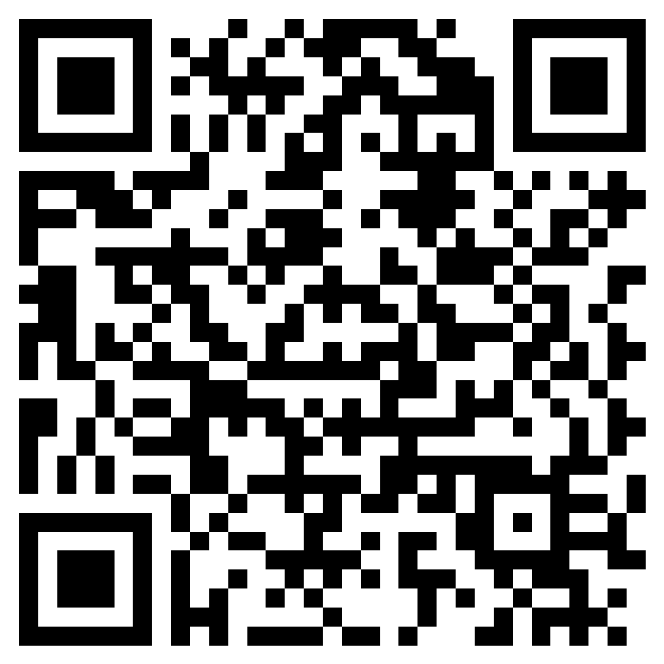

Questions or Concerns?
Have a question or concern? Click this QR code for our form and we will get back to you as soon as we can
*We know this is a new chapter in your life, so it’s okay and completely normal to feel nervous. Just remember we will always be here for you and are so glad you’re now apart of the Mad Beach family!

